Slide 1
Async Unit Testing
GRDevDay, 2015
Notes:
Scope: MSTest, NUnit, xUnit, Moq, Stubs – samples use MSTest
Lightning talk from CodeMash 2012 (just before WAT)
Async Unit Testing has changed a *lot* from then till now!
Also parallels my son: Nov 2011 – Feb 2015

Slide 2
Who is this guy?

Slide 3
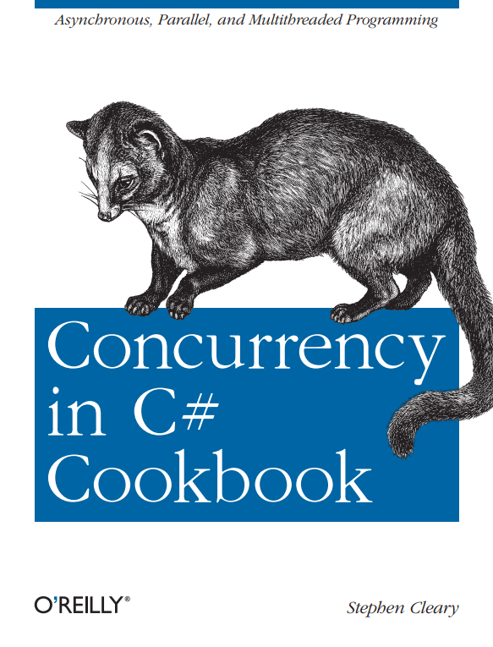

Slide 4

A(nother) Review of Async/Await

Slide 5
Introduction to Async
async Task DoNothingAsync()
{
// In the Real World, we would actually do something...
await Task.Delay(100);
}
The async keyword:
Enables the await keyword for that method.
Transforms the method into a state machine, very similar to the yield keyword.
That’s it!
Notes:
The async keyword can only be applied to a method.
Details of the transformation are not important; just be aware that there is a transformation going on.

Slide 6
Introduction to Async
async Task DoNothingAsync()
{
// In the Real World, we would actually do something...
await Task.Delay(100);
}
async Task DoNothingAsync()
{
Task delay = Task.Delay(100);
await delay;
}
await
Takes a single argument.
“Awaitable”
Usually a Task or Task<T>.
Notes:
“Await” is like a unary operator; it takes a single argument (like a cast).
This argument is an “awaitable”. I won’t get into the specifics, but an “awaitable” is a type that matches a certain pattern (similar to how foreach works).
An “awaitable” represents an asynchronous operation. In this talk, all our “awaitables” are Task objects.
Technically, you don’t “await” a method; you call the method and then “await” the Task it returns. But “await a method” and “awaitable method” are common phrases.
- Another method can await the task returned from DoNothingAsync, not b/c the method is async, but b/c it returns a Task.
Async methods start synchronously; so this method will (synchronously) call Task.Delay and then await.
Await is where things can start to get asynchronous.

Slide 7
Introduction to Async
async Task DoNothingAsync()
{
// In the Real World, we would actually do something...
await Task.Delay(100);
}
await behavior:
If awaitable (task) is complete, continues synchronously.
Otherwise:
Pauses the method and registers it with the awaitable.
Then returns.
Notes:
The “registering” is saying, “when you complete, please resume this method”.
When DoNothingAsync returns, it returns an incomplete Task.
This Task is completed when the DoNothingAsync completes (end of method or “return” statement).

Slide 8
Introduction to Async
async Task<int> AddTwoAsync()
{
int data = await GetIntAsync();
return data + 2;
}
What the Task means:
Represents the execution of the method.
Contains the result of the method (including exceptions).
Notes:
The returned Task represents this method; when this method completes, it will complete the Task.
Await “unwraps” the Task and retrieves its result (or raises an exception).
If a method returns a value (return statement), then that value becomes the Task’s result.
If a method throws an exception, then that exception is placed on the Task.

Slide 9
The Important Bits (for testing)
When testing an asynchronous (Task-returning) method, the important part to test is the Task that it returns.
This is one major reason why to avoid async void.
The await operator has special behavior when the asynchronous operation is already complete.
Notes:
The returned Task represents the async method.
The async state machine uses that Task to report completion, results, and exceptions.
Async void kills kittens.
DEMO

Slide 10
TDD in two minutes*
* Not really. Just the part of TDD that is really important for async unit testing.

Slide 11

The Red/Green/Refactor cycle.
Why “Red”?
The Red part of the cycle tests the unit tests.

Slide 12

Demo: When you skip Red
Notes:
Can anyone tell me why the exception doesn’t fail the unit test?

Slide 13
Avoid Async Void… … Unit Test Methods

Slide 14

Avoid Async Void
Notes:
How to get results from an async void method?
Can create a SynchronizationContext, use that to detect when async void method completes, and any exceptions it raises.
It *can* be done, but *should* we? No. Because it changes the test environment.
(I used to think otherwise).

Slide 15
Support for Async Void (which is bad)
MSTest rejects them with warning UTA007.
NUnit supports them in 2.6.2+ and 2.9.6.
They’ve already corrected this in 2.9.7.
xUnit currently planning to add support in 2.0.0.
Notes:
MSTest – never use async context
NUnit – use async context when necessary
xUnit – always use async context

Slide 16
Support for Async Task
Any unit test framework less than 3 years old!
MSTest – Visual Studio 2012
NUnit – 2.6.2 / 2.9.6
xUnit – 1.9
Xamarin… ?

Slide 17

Demo: Avoid Async Void

Slide 18

Exceptional Situations

Slide 19
Better than [ExpectedException]
ExpectedExceptionAttribute only passes the unit test if the test method raises an exception.
Better: Assert.Throws<TException>(() => testcode());
(Assert.ThrowsException for WinStore tests)
Notes:
ExpectedException only checks the test method as a whole.
Not good for more complex tests.
The better approach takes a delegate and executes it, observing exceptions.
ExpectedException does work for async unit tests (MSTest & NUnit).

Slide 20
Delegates need async help!
Async lambdas passed as Action parameters become async void (dun Dun DUN!!!)
Synchronous delegate with no return value:
Action – void Method();
Asynchronous delegate with no return value:
Func<Task> – Task MethodAsync();
Notes:
Anytime you have unit test helper methods (such as Assert.Throws) that take a delegate, those helper methods must be updated to also handle asynchronous overloads.
No, not async void! Those poor kittens!

Slide 21
Async Assert.Throws?
void Assert.Throws(Action);
Task Assert.ThrowsAsync(Func<Task>); // or “Throws”
Support:
MSTest – but only for WinStore unit test projects.
xUnit – 2.0.0 prerelease.
NUnit – ☹
Notes:
NUnit just treats asynchronous code in Assert.Throws as though it were an async void method.
They create a SynchronizationContext and execute the code within that, essentially creating a sync-over-async wrapper.
IMO a really bad approach but it may be too late to change for NUnit 3.

Slide 22
Demo: Async Exceptions

Slide 23
Async Stubs, Mocks, Doubles, Fakes, Dummies, …
Notes:
Terminology is fun.

Slide 24
Delegates, Again
Mocking frameworks generally have helper methods that are delegate-based, for setting up mock/stub behavior.
As long as your SUT is using async Task and not async void, this is not a problem.
But some frameworks also have a default behavior, which may not be what you want.

Slide 25

Demo: Async Stubs

Slide 26

Putting It All Together

Slide 27
A Quick Review
With async tests, we’re really just calling the system’s async method and then testing the task it returns.
Guidelines:
Avoid async void in your app. Seriously avoid it.
Never use async void unit tests.
Don’t skip the Red part of the TDD cycle.
Use your own helpers for exceptional situations.
Notes:
Avoid async void: even for ICommand.Execute, only use a tiny async void method that just awaits its async Task equivalent. The async Task version is testable!
Don’t skip the Red: especially if you’re new to async unit tests.
Use helpers: Hopefully all unit test frameworks will have better exception testing in the near future.
Also use helpers to change the MSTest stub defaults.

Slide 28
What Conditions to Test?
At least test the following service behaviors:
Asynchronous Success.
Asynchronous Failure.
But also consider:
Synchronous Success.
Notes:
“Service behavior” means this is the behavior of the stubs, and then test how your consuming class reacts to these scenarios.
For the paranoid, you could also test Synchronous Failure if you really want to.

Slide 29

Demo: Real-World (Almost)

Slide 30

The Advanced Topic

Slide 31
Contexts
Sometimes you need a context, e.g., ViewModels.
A general solution: AsyncContext in AsyncEx.

Slide 32

Contexts: Windows Store
You shouldn’t be using CoreDispatcher.RunAsync
But if you are… there is a workaround.
Notes:
(or BeginInvoke)
DEMO

Slide 33
Contexts: WPF
You shouldn’t be using Dispatcher.Invoke
But if you are… use WpfContext in https://github.com/StephenCleary/AsyncCTPUtil
Notes:
(or BeginInvoke)
DEMO

Slide 34
Contexts: WinForms
You shouldn’t be using Control.Invoke
But if you are… use WindowsFormsContext in https://github.com/StephenCleary/AsyncCTPUtil
Notes:
(or BeginInvoke)
DEMO

Slide 35
Q&A
Go forth and be awesome!
Notes:
Resources are available at StephenCleary.com - slides, example code, etc.

